Slide 1
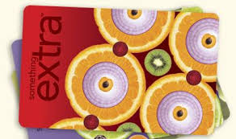
HOW CAN YOU HELP BY SHOPPING?

Slide 2
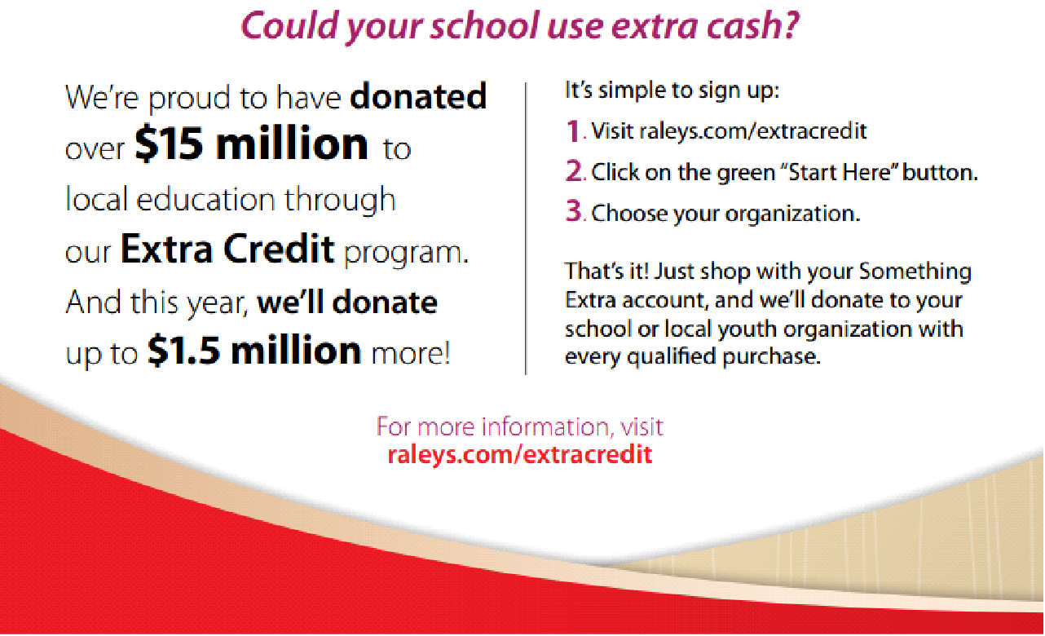
Raley’s – Bel Air
Extra Credit for Something Extra?
1.5% of total purchase goes to your choice of charitable organization “Gibson Elementary School PTA”
Must sign up with the Something Extra program. www.Raleys.com
No card needed just use your Phone # at the register

Slide 3
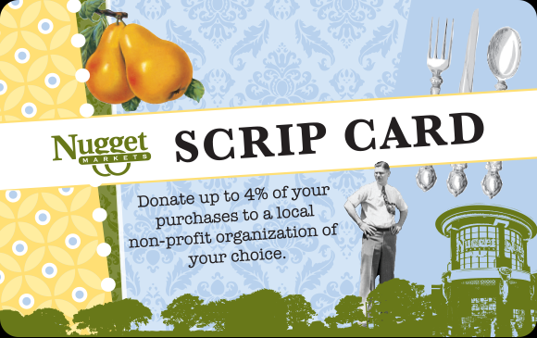
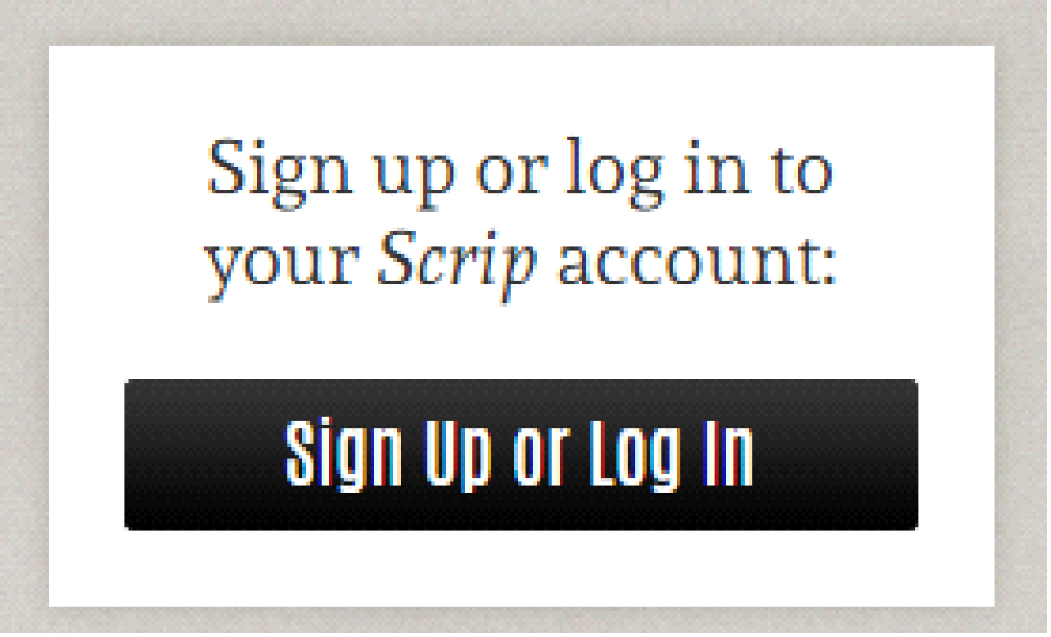
Scrip Program
Nugget Markets wants to be a good neighbor—we support more than 350 non-profit, youth educational and religious organizations with more than $10,000 in monthly donations! Our Scrip program is 100% free to participants and beneficiaries, making it easier than ever to give back to the local community. Your Nugget Markets Scrip card enables you to donate up to 4% of your monthly purchases and split your contribution between up to four local non-profits of your choice.
http://www.nuggetmarket.com/community/
Renew every 2yrs calendar days ( Reminders sent Via snail mail and E-mail.)
Must have script card on hand to
You can you use your Nugget or Food4Less card for one or the other.

Slide 4
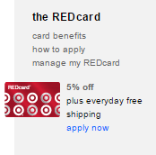
TARGET
Do you have a Target Debit / Credit Card?
Target gives 1% back from every purchase made with you Target REDcard.
Must register your card at target.com and click on the
“manage my REDcard” icon.
Do not have to re-register every year.
Target Contributions are allocated through school administration.

Slide 5
amazon
AmazonSmile is a website operated by Amazon that lets you enjoy the same wide selection of products, low prices, and convenient shopping features as on Amazon.com. The difference is that when you shop on AmazonSmile (smile.amazon.com), the AmazonSmile Foundation will donate 0.5% of the purchase price to the eligible charitable organization of your choice.
ONLINE SHOPPER?
Must have a amazon account
Go to (smile.amazon.com) then select you charitable group “Gibson School PTA”
Shop on Smile.amazon.com for the same the shopping experience as Amazon.com

